Slide 1
SPEAR
Surveying and Planning through Electronic Applications and Referrals

Slide 2
Welcome

Slide 3
Agenda
Welcome
100% Digital Lodgment
SPEAR Electronic Lodgment Network
Plan Branch Update
Digital Cadastre Modernisation Program
SPEAR IT
Morning Tea

Slide 4
Agenda
Geographic Names Victoria
ePlan Update
Co-Design of standard CAD file
SPEAR Service Desk update
Closing / Questions
Lunch

Slide 5
100% Digital Lodgment

Slide 6
100% Digital Lodgment
In line with the Victorian Government’s digital strategy, the Registrar has consulted with stakeholders about transitioning to 100% digital lodgment
Time frames have been published in the Land Use Victoria Customer Information Bulletins
All transactions to be lodged electronically from August 2019 (except SPEAR ELN transactions)
All transactions to be available for electronic lodgment from August 2019 (SPEAR ELN)

Slide 7
100% Digital Lodgment
SPEAR ELN transactions available August 2019
Subdivision Act 1988
Section 33(1) Alteration of lot entitlement and liability*
Section 38 Amendment to accessory lot*
Section 38A Removal of restricted lot status*
Section 38B Amend scheme of development – Owners corporation
Section 38C Amend scheme of development – Lot owner
Local Government Act 1989
Section 207D Transfer of closed road
Section 207E Transfer of road exchange
Major Transport Projects Facilitation Act (MTPFA)
* Stand-alone lodging party transaction

Slide 8
100% Digital Lodgment
Transfer of Land Act 1958
Section 15 Application to bring land under the operation of the Transfer of Land Act 1958
Section 26P(1) Application for deletion of warning relating to title dimensions
Section 60(1) Application for a vesting order based on title by possession
Section 98CA Conversion of building subdivision
Section 99(1) Application for amendment to boundaries, area or position
Section 103(2) Application to correct land description in the Register to accord with plan
Section 45 Creation of easement
Section 72 Recording of easement
Section 88(2) Acquisition of easement or right
Request to waive survey for an adverse possession application*
Section 28 Register a Crown grant*
Section 28 Register a Crown lease* * Stand-alone lodging party transaction

Slide 9
100% Digital Lodgment
Road Alignments
Lodged by surveyors
SPEAR ELN registration not required

Slide 10
100% Digital Lodgment
Subject to Registrar’s approval, it is proposed that Licensed Surveyors submit ALL plan and survey based applications in SPEAR from 1 January 2020
Intention is, lodgments that are supported by paper plans and/or surveys will be refused by LUV after this proposed date

Slide 11
100% Digital Lodgment
Registrar will update the Registrar’s Requirements that plans and surveys are submitted in SPEAR
This applies to all applications supported in SPEAR under the following Acts:
Subdivision Act 1988
Transfer of Land Act 1958
Local Government Act 1989

Slide 12
100% Digital Lodgment
Transition arrangements will be in place for plans which were submitted before 1 January 2020
The following can continue in paper:
Plans submitted to council prior to 1 January 2020
Plans and surveys first certified by the Licensed Surveyor prior to 1 January 2020
Plans not submitted by a Licensed Surveyor (e.g. Removal of Restriction)
Plans not yet supported in SPEAR (e.g. plans affecting multiple LGAs)

Slide 13
100% Digital Lodgment
98% of plans were submitted in SPEAR in 2018, thus the impact on industry is expected to be minimal
Surveyors are encouraged to start submitting all plans and surveys in SPEAR, if not already doing so
It is recommended that councils refuse all paper certification and joint applications received from Licensed Surveyors from 1 January 2020, as these will not be accepted for lodgment by the Registrar

Slide 14
100% Digital Lodgment
Land Use Victoria will draft a consultation paper on requiring solicitors and conveyancers to lodge electronically using the SPEAR ELN
It is proposed that Licensed Surveyors will be required to electronically lodge Boundary Plans and Road Alignments
99% of Boundary Plans are currently lodged electronically

Slide 15
SPEAR Electronic Lodgment Network

Slide 16
SPEAR Electronic Lodgment Network
Current lodging party user statistics:
87 SPEAR ELN Subscribers
100+ in the process of registering
New SPEAR ELN Subscribers are being broadcast on SPEAR as they become active
A full list of SPEAR ELN subscribers can be found on the SPEAR website:-
https://www.spear.land.vic.gov.au/spear/spearOrganisations/List.do

Slide 17
SPEAR Electronic Lodgment Network
Future process changes:
External provider to provide VOI services for director/s or partners signing up to the SPEAR ELN
Skype training and remote digital certificate installation

Slide 18
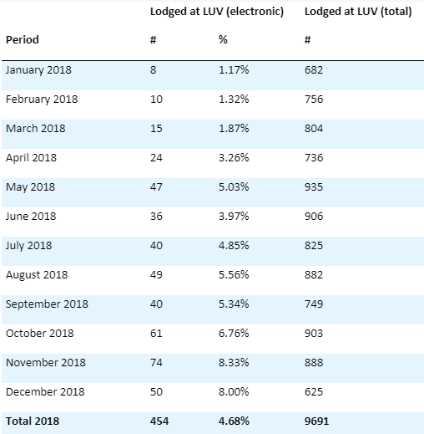
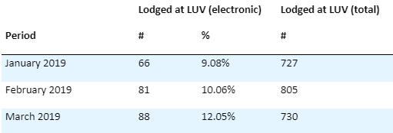
SPEAR Electronic Lodgment Network
10% electronic lodgments
Over 800 transactions lodged electronically
300+ upcoming lodgments

Slide 19
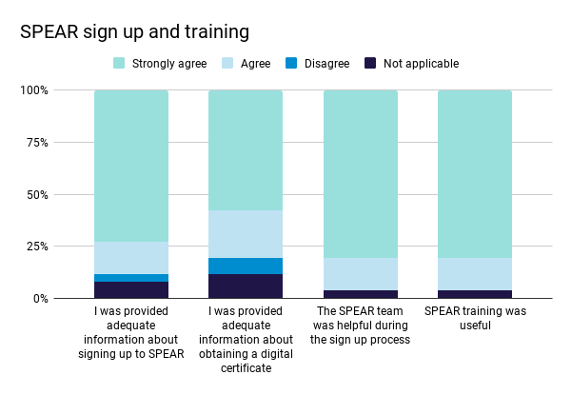
SPEAR Electronic Lodgment Network
SPEAR ELN user survey conducted November 2018

Slide 20
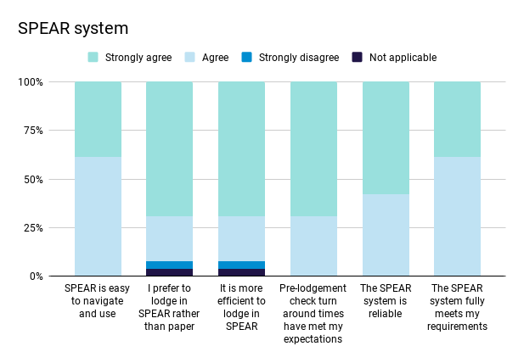
SPEAR Electronic Lodgment Network
SPEAR ELN user survey conducted November 2018

Slide 21
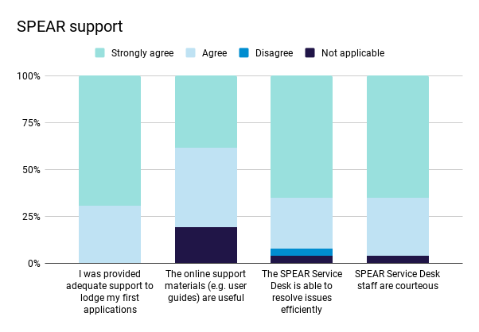
SPEAR Electronic Lodgment Network
SPEAR ELN user survey conducted November 2018

Slide 22
SPEAR Electronic Lodgment Network
“
Love it – it is a lot quicker and easier than paper lodgement
Naomi Hillas, Beaumont Lawyers
“
Very easy to use – has made lodging subdivisions much easier
Sarah Francis, SF Conveyancing

Slide 23
SPEAR Electronic Lodgement Network
Enhancements based on user feedback:
More control over who can pay and lodge
Ability to request access from surveyors
Automatic watching
View Refusal link – easier to find lodgment refusals

Slide 24
Plan Branch Update

Slide 25
Plan Branch Update
RECRUITMENT / TRAINING
AUTOMATING TITLE CREATION
AUDIT PROGRAM
MTPFA - Major Transport Projects Facilitation Act
PLAN ACCEPTANCE
Section 26Y Transfer of Land Act
GAIC in SPEAR
BUSINESS ENQUIRIES
SUPPLYING OC SPREADSHEET

Slide 26
RECRUITMENT / TRAINING
2
SPEAR Project Officers
VPS 4
8
Trainee Plan Registration Officers
VPS 2
2
Phone Support Administration Officers VPS 2
3
Trainee Crown Project Officers
VPS 2

Slide 27
AUDIT PROGRAM
All plan examiners are audited during the year.
The purpose of the audit program is to identify training issues, improve consistency in examination and provide personal development.
Audit includes:
- Plans
- Field records
- Created folios
- Victorian Online Titles System (VOTS)
- Consequential amendments
- Application forms

Slide 28
AUDIT PROGRAM
Once an audit is completed, a report of the audit is prepared and sent to the audited examiner, Branch Manager, Work Unit Manager, Training Manager & the Work Unit Specialist.
Feedback is provided by the auditor to the individual (one on one).

Slide 29
PLAN ACCEPTANCE
CURRENT
FUTURE
Plan Acceptance counter is in the process of being phased out and will cease face to face lodgements from 1st November 2019.
From the 1st November 2019, any subdivisional lodgements and plan related dealings must be placed in the ‘Drop Off’ Basket for lodging.
Currently the ‘Drop Off’ basket at Reception for plans and plan-related dealings will generally be lodged on the same day. Confirmation of lodgements or refusals can be picked up from the Reception desk.
All ‘one off customers’ will be assisted by staff if required.

Slide 30
GAIC in SPEAR
SRO is required, where a property is affected by a GAIC (Growth Area Infrastructure Contributions) notice, to provide either a removal of notice or consent to registration (sometimes both) to precede registration of a plan of subdivision
Initial discussions between SRO and LUV proposed SRO provide GAIC consent or remove GAIC notice when land is subject to a subdivision application in SPEAR

Slide 31
GAIC in SPEAR
Benefits:
Ensures GAIC consent / removal is lodged in conjunction with the plan, avoiding timing issues
Ensures plan and GAIC dealings are processed together
Enables lodging party (solicitor / conveyancer) to pay any associated GAIC lodgment fees

Slide 32
Supplying Owners Corporation Spreadsheet
Since SPEAR Release 4.2 (November 2015), surveyors have been able to supply their Owners Corporation (OC) data onto a spreadsheet and upload it in SPEAR
Once supplied, SPEAR validates and generates the OC schedule from the data and attach it to the plan PDF
The OC schedule spreadsheet template is available within SPEAR and on the SPEAR website - refer to Tech Note 4

Slide 33
Supplying Owners Corporation Spreadsheet
A master macro-enabled spreadsheet is also available to specifically support plans with multiple OC’s
Maintaining your OC data in the master macro spreadsheet ensures you only need to make changes in the one place. The spreadsheets that are ultimately uploaded in SPEAR are automatically generated from this master spreadsheet and a date/time stamp is added to each OC.

Slide 34
Automating Title Creation
As part of the subdivision registration process, plan examiners are required to setup and create new titles for all new parcels
In a future enhancement of the Victorian Online Titles System, creation of new titles will be pre-populated with the new parcel information contained in the ePlan (LandXML) file

Slide 35
Major Transport Projects Facilitation Act
Major Infrastructure Projects and Updating the Register
Projects are aligned to delivering capabilities with future needs around:
Roads
Rail Networks
Projects Authorities will update the Freehold Register and the newly created Crown Register (August 2016) by recording their acquisitions.
Land Use Victoria has worked with relevant stakeholders to implement a streamlined process, resulting in a new dealing type.

Slide 36
Major Transport Projects Facilitation Act
In 2009, the state government passed a bill that created the Major Transport Projects Facilitation Act (MTPFA).
This Act allows for the acquisition of land in both Crown and Freehold.
A section was included to ensure updating of the Register:
“Make any recordings in the Register that are necessary because of the operation of this Act…”
The Register is now maintained by lodging a Section 259 MTPFA dealing.

Slide 37
Section 26Y TLA 1958
Removal of warnings on Provisional folios after 15 years.
LUV will undertake a project to ensure that folios affected under Section 26Y of the Transfer of Land Act 1958 are rectified to accord with the legislation.
Transfer of Land Act 1958
Section 26Y: Provisional folio becomes an ordinary folio after 15 years
    A provisional folio of land brought under this Act becomes an ordinary folio, unless an ordinary folio of the land has otherwise been created, 15 years after the creation of the provisional folio.

Slide 38
This section has been in place since September 2017 and the legislation does have consequences for those who may benefit from Sec 26P of TLA, as Warnings as to Dimensions will be removed as part of this process.
The Registrar will continue to examine those 26P applications currently lodged with LUV. However, it is
advised that research be undertaken on any folio with the warning to ensure if it is in the 15-year period or not.
If beyond the 15-years, the Registrar will not entertain the use of 26P even if the warning is still shown on the folio and or Title Plan (TP).
Section 26Y TLA 1958

Slide 39
Section 26Y TLA 1958
The Checklist supporting the lodgement of Section 26P applications will be updated accordingly, to ensure those seeking to undertake this process go through the required checks.
There will be a project to remove the expired warnings from the folios, however this process will take some time and as a result a warning may appear on a folio or diagram that is no longer in effect.

Slide 40
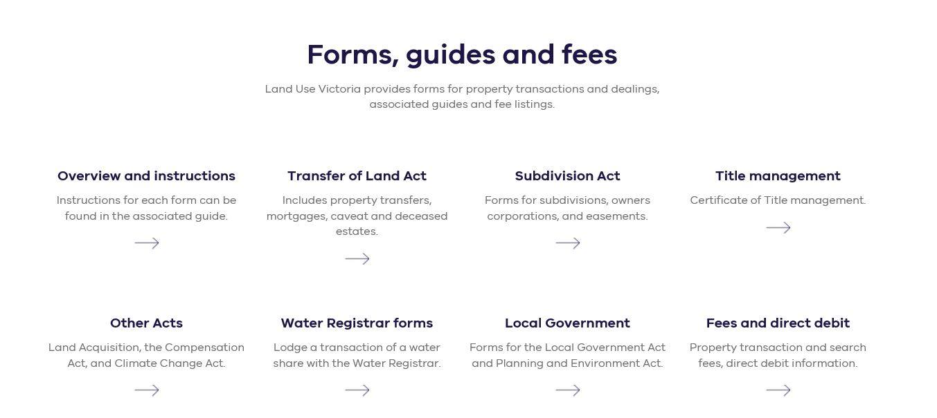
BUSINESS ENQUIRES
Detailed information relating to Land Titles can be found on our website
https://www.propertyandlandtitles.vic.gov.au/land-titles/subdivision-and-consolidation
Information relating to Forms, guides & fees can be found via the following link:
https://www.propertyandlandtitles.vic.gov.au/

Slide 41

QUESTIONS ?

Slide 42
Building Victoria’s Cadastre for the Digital Future
Victoria’s Digital Cadastre Modernisation Project

Slide 43

Watch our video
https://www.youtube.com/watch?v=KNqtuy8MbwE

Slide 44
The project
This project is about improving the accuracy of the State’s Digital Cadastre
Has been referred to as the Digital Cadastre Modernisation project or ‘DCM’
Terminology note
We are actually referring to the digital representation of the cadastre, but for brevity the project will be known as the Digital Cadastre

Slide 45
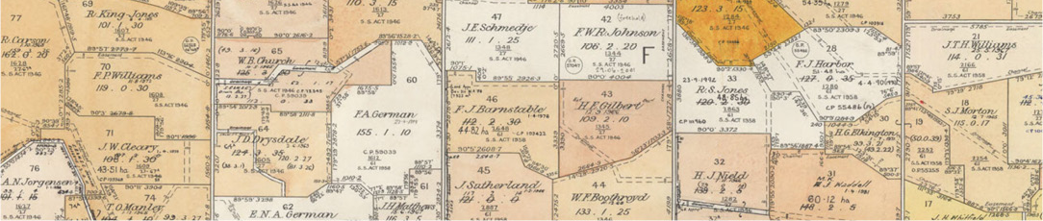
Key Points
Four Years
$45m Investment
Four inter-related stages & deep stakeholder engagement
Innovation and early realisation of benefits

Slide 46
Why?
The current digital representation of the cadastre is missing large amounts of important survey positioning data which is still in paper and PDF formats - much of it in archives.
There are significant spatial inaccuracies in the current cadastral boundaries represented in Vicmap Parcel and Property.
Missing data and inaccuracy inhibits efficiency and productivity gains which are important for the Victorian economy.

Slide 47
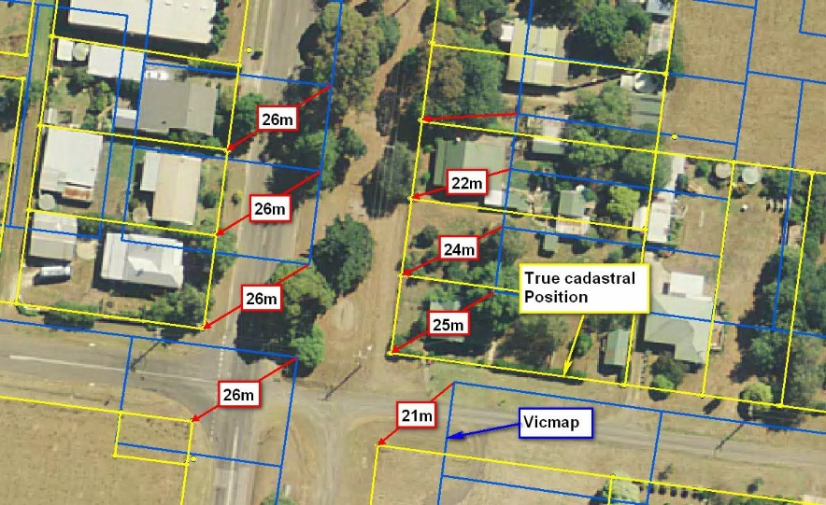
Boundary Inaccuracy not sustainable in a digital world
Current Vicmap property boundaries
Real world boundaries

Slide 48
Project Phases
Back Capture
Adjust
Integrate
Accurate data from each plan is captured and converted into a digital record
Data from plans is joined and mathematically adjusted to improve spatial accuracy
The updated data is published, and changes in location cascaded through all Vicmap layers
Automate
Development of automated processes to:
keep the digital representation of the cadastre up to date and spatially accurate
align other datasets to the cadastre (as defined in “Integrate”)

Slide 49
The Team
The project is situated in Land Use Victoria at DELWP
Team of 16 and growing, including:
Roger Fraser - Chief Geospatial Scientist
David Blain - Integration Manager

Slide 50


Project Phases
Subdivision Data
Updated via SPEAR
Back Capture
Adjust
Integrate
Accurate data from each plan is captured and converted into a digital record
Data from plans is joined and mathematically adjusted to improve spatial accuracy
The updated data is published, and changes in location cascaded through all Vicmap layers
Automate
Development of automated processes to:
keep the digital representation of the cadastre up to date and spatially accurate
align other datasets to the cadastre (as defined in “Integrate”)

Slide 51

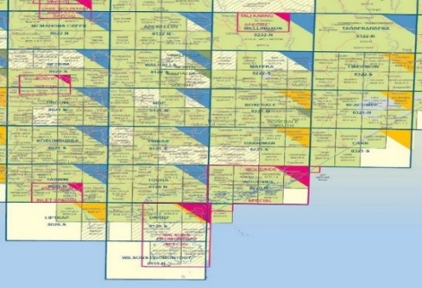


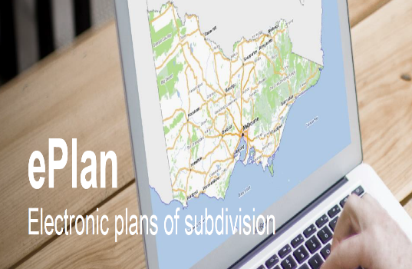
Digital cadastre modernisation
Back Capture Stage
Accurate data from each paper plan is converted into a digital record (LandXML)
Adjust Stage
Data from individual plans is joined and adjusted to fully align (within 50cm rural and 10cm metro)
Automate Stage
Updating future data and use of newly back captured files in modern systems
Integrate Stage
The new cadastre is published in the state's authoritative map base (Vicmap), and location changes cascaded though other Vicmap Products and made available to the public

Slide 52




Identified project benefits
Increased spatial accuracy
Increased productivity and efficiency
Increased innovation
Benefit of starting now

Slide 53
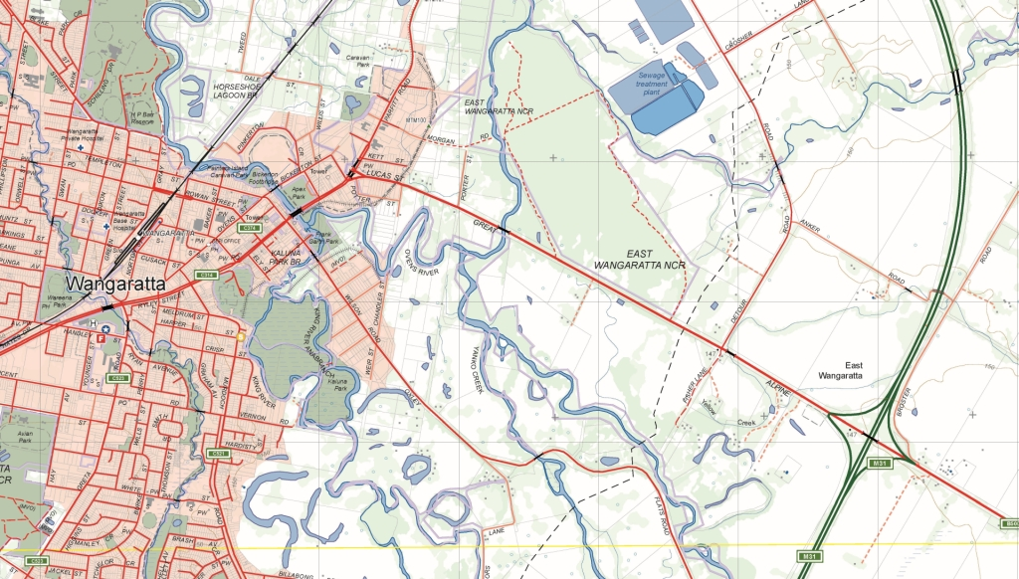
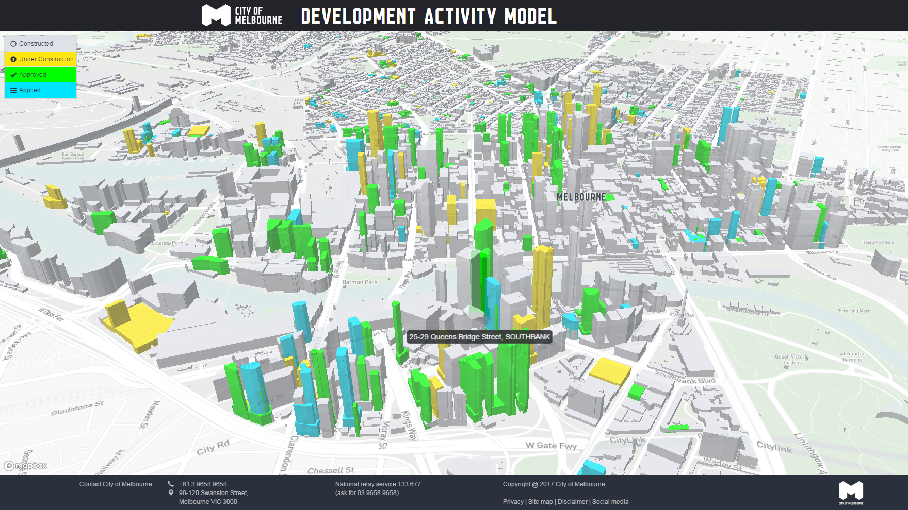

Improving core business through innovation

Slide 54
Stakeholder engagement and change management

Slide 55
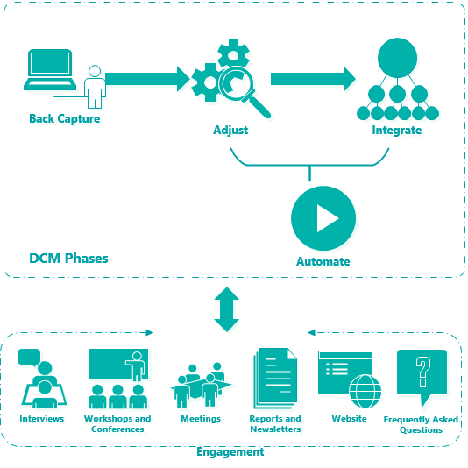
Engagement
What we want to explore with you:
How will DCM impact your workflows and business?
When and how do you want to get information?
How can we involve you during the Integrate and Automate phases?
What do we need to be aware of?
Do you need to make us aware of any impacts - e.g. legal implications?
How this project intersects with other change processes (e.g GDA2020, ePlan)?

Slide 56
How to get involved
Nominate to sit on one of the Stakeholder Reference Groups for this project
State and Local Government
Reference Group
  from all relevant areas, from all tiers of government and government agencies
Industry and Research Reference Group
  Utility Providers
  Surveying profession
  Spatial profession
  Universities/researchers
  Training providers
  Data aggregators
  Building, property and construction sector
  Industry bodies

Slide 57
7. Industry and Government Reference Groups - Process
Develop TOR and EOI
Mid-April
Call for EOI
Late April
Appoint Stakeholder Reference Group
Late May
SteerCo endorsement
PCB #14
Cadastre Data Creators/ Managers
Creators/Maintainers of data in other VicMap themes
Creators/Maintainers of dependant datasets and products
Users of Vicmap Datasets and Products
Surveyors (Melbourne Water, Local Government, Vicroads)
GIS/Rates Officers, LGA
GIS officers, Vicroads
DELWP Planning, DELWP Crown Land, Surveyor-General
Utilities
Asset Managers
CMAs
PSMA
Data Service Providers
DELWP (eg Valuer General, GovMap, Victoria Unearthed )
Emergency Services
All others in previous categories
General Public
Cadastre data managers (Melbourne Water, NELA/LXRA, Local Government or Vicroads)
Parks Victoria
WoVG
Industry
Cadastre Data Creators/ Managers
Creators/Maintainers of data in other VicMap themes
Creators/Maintainers of dependant datasets and products
Users of Vicmap Datasets and Products
Surveyors (e.g. ISV, CSV)
Surveyors (e.g. ISV, CSV)
Utilities
CMAs
PSMA
Data Service Providers
Mining
General Public
Web developers
Property and construction
Oil and gas
Engineering
Planning and environment

Slide 58
Criteria
Diverse representation across both industry, geography, background and perspective
Well-networked in sector they represent
Committed to acting as an industry advocate
Motivated to contribute positively and constructively to the debate in a respectful and collaborative fashion
Relevant skills and experience
Able to commit to the work.

Slide 59
Keep updated on our project
Katherine.Williams@delwp.vic.gov.au
Susanna.Collis@delwp.vic.gov.au
https://www2.delwp.vic.gov.au/maps/digital-cadastre-modernisation-project/digital-cadastre-modernisation-project

Slide 60
SPEAR IT

Slide 61
Activity Outcomes from 2018 UGM
34% of UGM vote
Allow internal referral authorities to indicate the nature of their response
Scheduled for Release 4.9: May 2019
27% of UGM vote
Allow site photos to be uploaded in JPEG format
Scheduled for Release 5.0: November 2019

Slide 62
Releases
Current release schedule
Release 4.9 – 24th May 2019
Release 4.9.5 – August 2019
Release 5.0 – November 2019
2020 and beyond: Future Releases

Slide 63
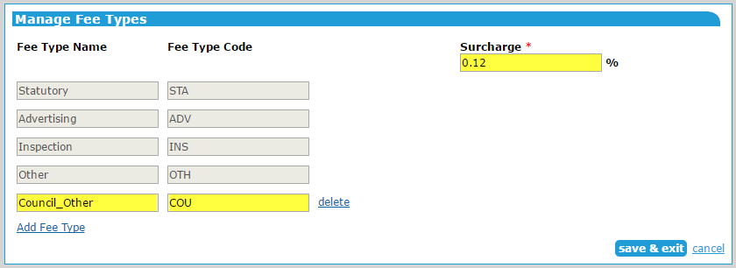
Release 4.9
Responsible Authority Manage Fee Types
Enable Responsible Authority Local Administrators to:
define a credit card surcharge (if applicable)
configure custom fee types

Slide 64
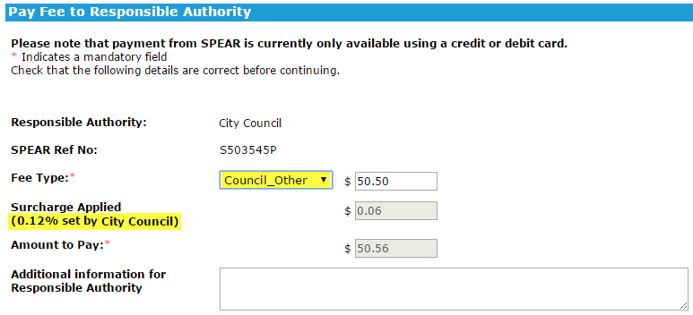
Release 4.9
Responsible Authority Manage Fee Types
The custom fee type and surcharge amount will be visible to the user on the Payment screen with the calculated surcharge added to the amount payable

Slide 65
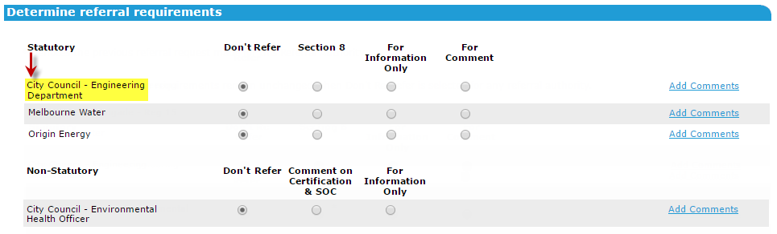
Release 4.9
Non Statutory referral authority
SPEAR to allow Responsible Authorities to define an internal referral site, as a statutory referral authority

Slide 66
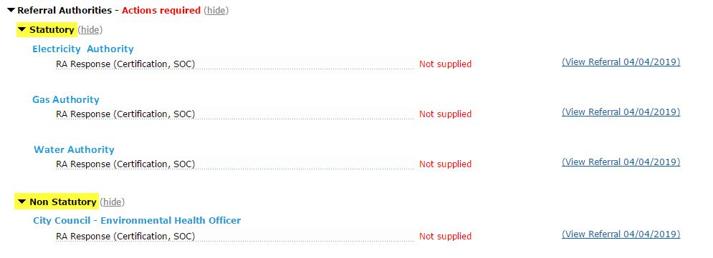
Release 4.9
Referral Authority
Referral authorities will be displayed as either statutory or non statutory on the Details screen and on the Determine Referral Requirements screen

Slide 67
Release 4.9
Non Statutory referral authority
Non-statutory authorities (internal referrals) will indicate the nature of their response to a referral request, similar to a statutory referral authority
Example: A permit referral would allow the following response options:
  Consent
  Object
  Further Action Required
  No referral required

Slide 68
Release 4.9
Non Statutory referral authority
NOTE: A ‘further action required’ response from a non-statutory authority is not an RFI and does not prompt the surveyor to respond
If required, the Responsible Authority user should request further information from the Applicant Contact in SPEAR

Slide 69
Release 4.9
Expiring a planning permit
Responsible Authority users will be able to ‘Expire Permit Application’ and move it to the Completed list
This overcomes the issue where new plans for endorsement are required, but the permit expires before they have been supplied by the Applicant Contact

Slide 70
Release 4.9
Expiring a planning permit
Planning permit expiry is supported by:
PDF / free text justification
New notifications to Applicant Contact and referral authorities advising that the application has been expired
Activity log event showing that the application has been expired and moved to the Completed list
Improved planning permit expiry warnings / reminders to the Applicant Contact and Responsible Authority, at three months and one month before the permit is due to expire

Slide 71
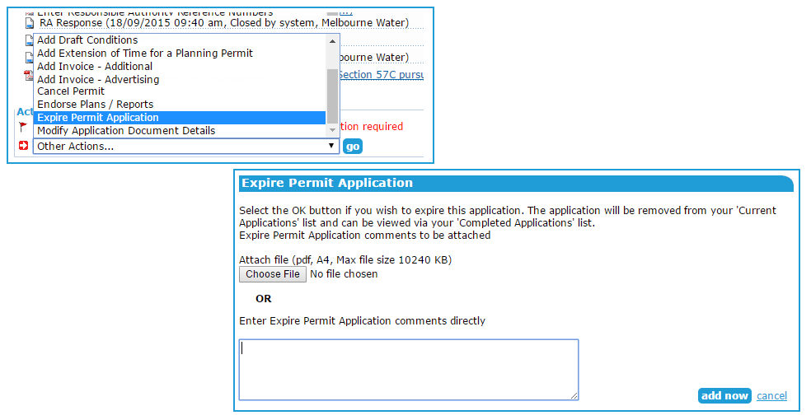
Release 4.9
Expiring a planning permit

Slide 72
Release 4.9
Confirm / amend permit number
As part of the Certification Decision, the Responsible Authority will need to confirm the planning permit reference number when the status of the originally described planning permit is:
Lapsed Not Required Refused | Withdrawn Cancelled Expired

Slide 73
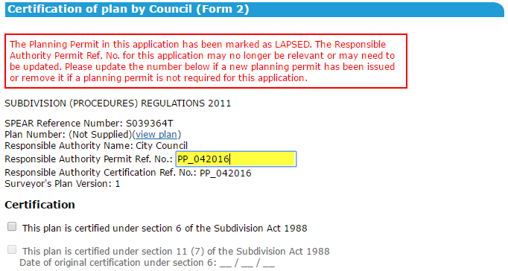
Release 4.9
Confirm / amend permit number
A warning will appear on the Certification screen prompting the user to review the reference number and update on screen

Slide 74
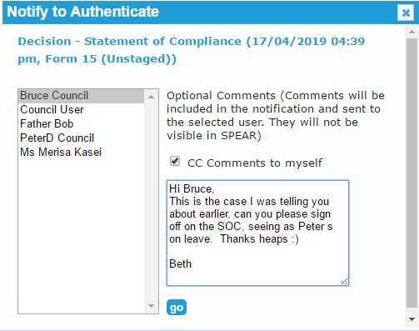
Release 4.9
Enhance work-flow notification functionality
Users may add comments (optional) when using the ‘Notify for Authentication’ action
Comments will not be visible in SPEAR, or stored in application
Comments will only appear in the email notification(s) sent by the system

Slide 75
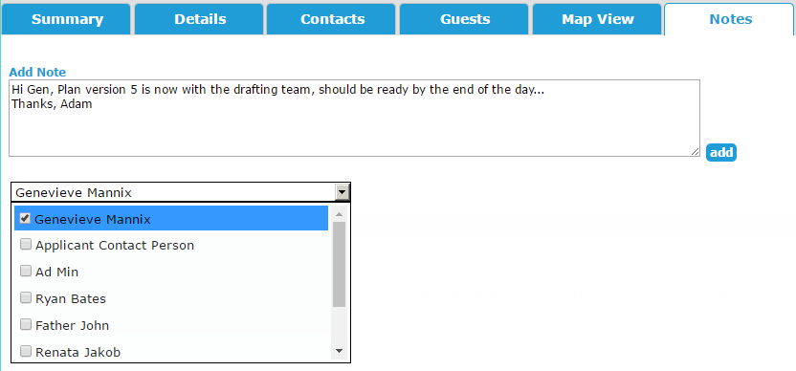
Release 4.9
Improve ‘Notes’ functionality
Update the Notes tab to allow users to notify other users within their organisation when a new note has been added

Slide 76
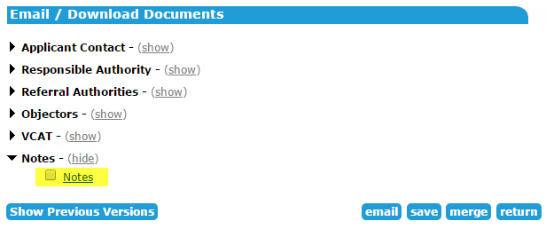
Release 4.9
Improve ‘Notes’ functionality
If notes exist at your organisation, allow them to be accessed from the Email / Download Documents screen

Slide 77
Release 4.9.5
Extend SPEAR ELN to support additional applications
Extend the SPEAR Electronic Lodgment Network (ELN) to cater for additional application types to be created and/or lodged by either Applicant Contact, lodging party or both
To improve existing ELN functionality with enhanced workflows and usability improvements

Slide 78
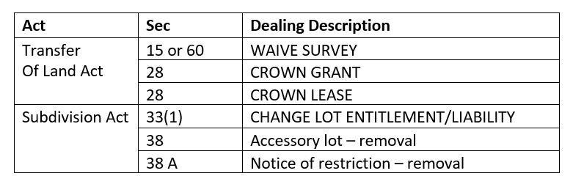
Release 4.9.5
Extend SPEAR ELN to support additional applications
Lodging party is able to create some applications without the surveyor initiating the process in SPEAR
Applications that are created only by the lodging party:

Slide 79
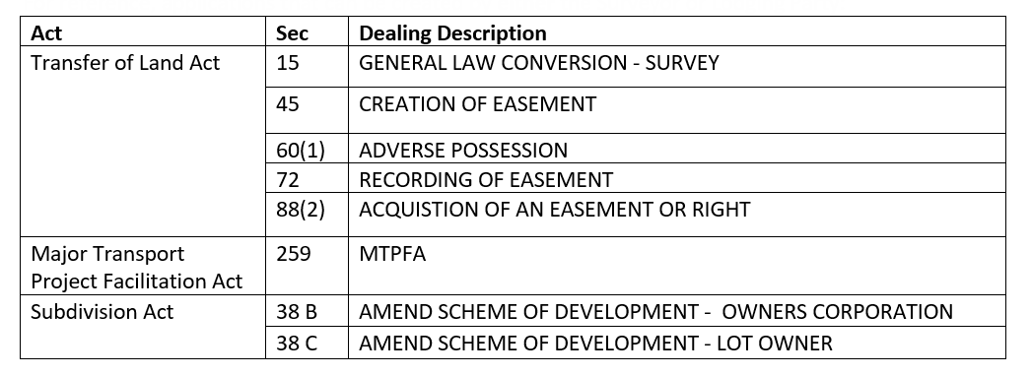
Release 4.9.5
Extend SPEAR ELN to support additional applications
Applications that can be created by either the surveyor or lodging party:

Slide 80
Release 4.9.5
Extend SPEAR ELN to support additional applications
Enable electronic lodgment of Crown grant applications in SPEAR:
Crown Grant dealings will be specifically created and lodged by users from the Department of Treasury and Finance
Enable electronic lodgment of Crown Lease applications in SPEAR by DELWP and other users associated with alpine regions

Slide 81
Release 4.9.5
Extend SPEAR ELN to support additional applications
Allow surveyor to create an electronic lodgment form for Road Alignments – Local Government Act, similar to the existing process for lodging Boundary Plans
Allow TLA, LGA, OTH and OP applications to be displayed in the public search so that lodging parties can search and obtain the SPEAR reference number to requests for lodging party access

Slide 82
Release 4.9.5
Extend SPEAR ELN to support additional applications
Remove the requirement to nominate a title for an electronic lodgment if the lodging party controls it (eCT only)
Allow lodging party access requests to be made after an application is released for lodgment

Slide 83
Release 5.0
Java replacement to support digital signing
To be discussed in more detail in the Service Desk Update
Surveyors to purchase plan numbers through SPEAR
Allow surveyors to purchase plan numbers through SPEAR, indicate how many are required, online payment, and digital download of purchased numbers

Slide 84
Release 5.0
Improve document upload process to cater for multiple uploads
Allow JPEG files to be uploaded
This change will improve efficiency and user experience when attaching multiple documents, such as copies of title or site photos. Part of this change proposes to allow additional file types such as JPG to be uploaded to SPEAR

Slide 85
Release 5.0
Improve the way SPEAR handles address entry
Improve document grouping
Display related documents (e.g. a superseded planning permit and an amended planning permit) as a single line-item on the Details screen. Once clicking on the single item, SPEAR should display the current document and any superseded versions

Slide 86
Release 5.0
Improvement to the guest invitation process
Allow the Applicant Contact to cc themselves when inviting guests into an application. This will copy the request, together with any optional text to the Applicant Contact for their records

Slide 87
Release 5.0
Improve payment error code message
Display the correct contact instructions depending on the category of error, resulting in a better customer experience when things go wrong

Slide 88
Release 5.0
Provide the ability for VicRoads to submit SP plans in SPEAR
Allow for VicRoads SP (Survey Plan) applications under the Road Management Act to be created and submitted in SPEAR

Slide 89
Future Releases: 2020 and beyond
Add an address book to pre-populate client details and email addresses
Introduce a re-certification process for Plans of Crown Allotment (OPs)
Develop a work flow for handling plans that span two or more municipalities
Check surveyor’s registration status when signing in SPEAR

Slide 90
Future Releases: 2020 and beyond
Allow referral authorities to compile their responses from a list of standard response options which they maintain
Remove the requirement for surveyors to re-sign a document after rotating it
ePlan to support additional dealing types including, SGV, TLA and LGA dealing types

Slide 91
SPEAR Modernisation Project
SPEAR is undergoing a modernisation refresh by upgrading its technologies and framework
This project has just commenced, with completion expected in June 2020
Current SPEAR functionality will not change and ESU are being provided weekly updates through the life of the project

Slide 92
Morning Tea

Slide 93
Update from GNV
SPEAR UGM 2019

Slide 94
AGENDA
Subdivision audits
  Statistics
  New resource
How to comply with the Naming rules for places in Victoria
  Linking the name to the place
  Statutory requirements
  Living or deceased?
International Year of Indigenous Languages
  Initiatives
  Workshops
  Involvement

Slide 95
Subdivision Audits

Slide 96
Subdivision audits - Statistics

Slide 97
New Resource / opportunities
Focus on audits of plans of subdivision,
Increase in compliance rates
Education / Training

Slide 98
Compliance

Slide 99
Principle C Linking the name to place
How to do this?
Who can help?
Aboriginal culture and occupation of the land,
Local flora and fauna,
Australian war contributions,
European exploration and settlement,
Local geography and geology,
European exploration and settlement,
Significant events,
Cultural diversity of past and current inhabitants, or
Patterns of land usage and industrial/mineral/agricultural production.
Council,
RSL,
Historical Society,
Traditional owners.

Slide 100
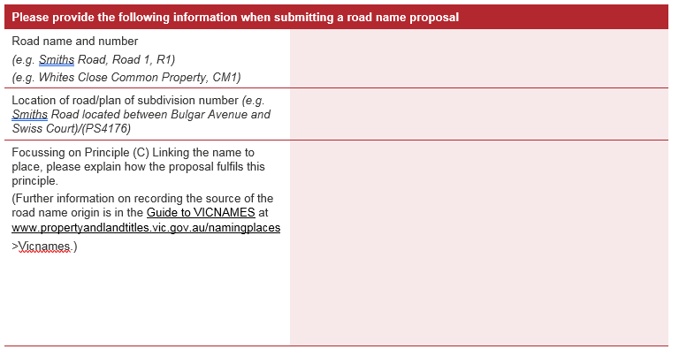
Road name history/origin form
https://www.propertyandlandtitles.vic.gov.au/naming-places-features-and-roads/naming-rules-for-places-in-victoria

Slide 101
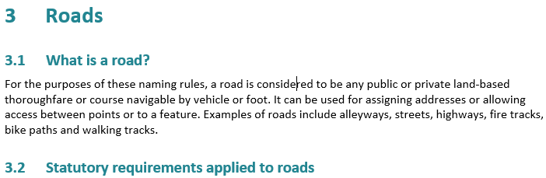
Naming rules for places in Victoria - 2016
3.2.1 Rural and urban addressing
3.2.2 Extent: Road course and start and end points
3.2.3 Road Types
3.2.4 Unacceptable road names
3.2.5 Obstructed or altered roads

Slide 102

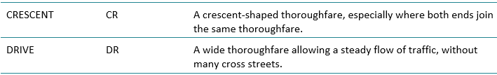
Appendix A Road types accepted for registration
Popular road types
Appendix A is available online:
https://www.propertyandlandtitles.vic.gov.au/naming-places-features-and-roads/naming-rules-for-places-in-victoria

Slide 103
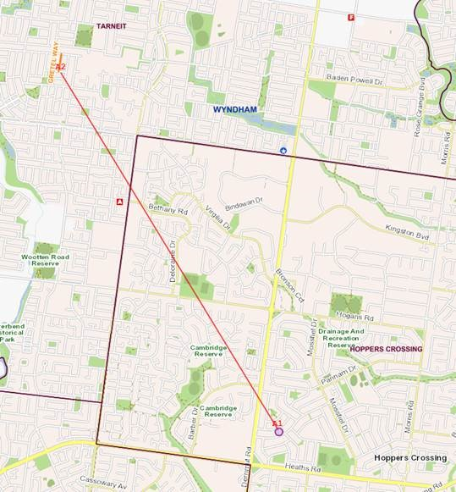
What not to do - Duplication

Slide 104
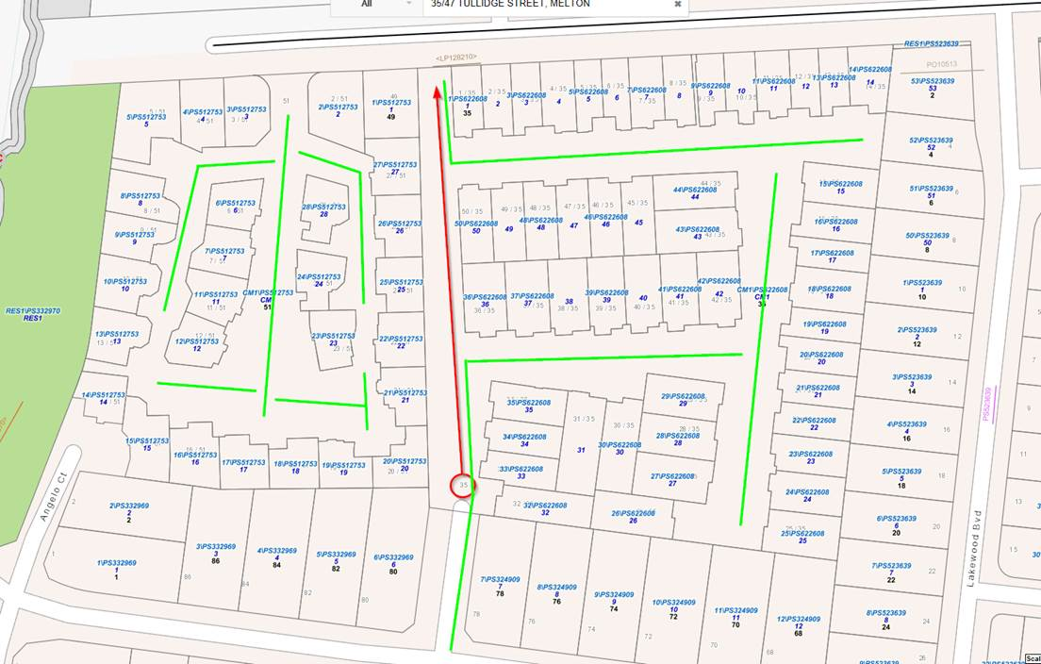
Naming Common property / Driveways

Slide 105
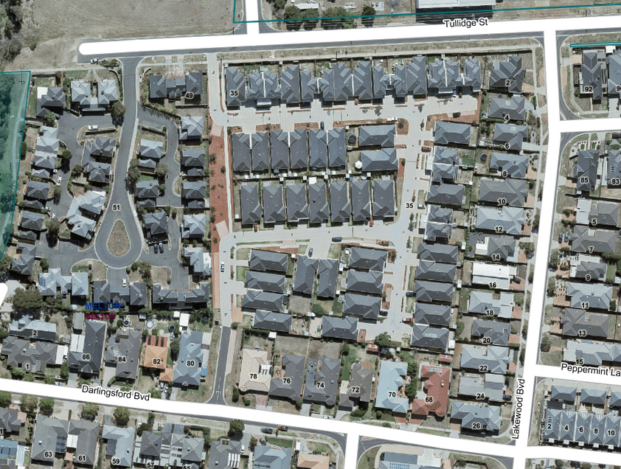
Naming Common property / Driveways

Slide 106
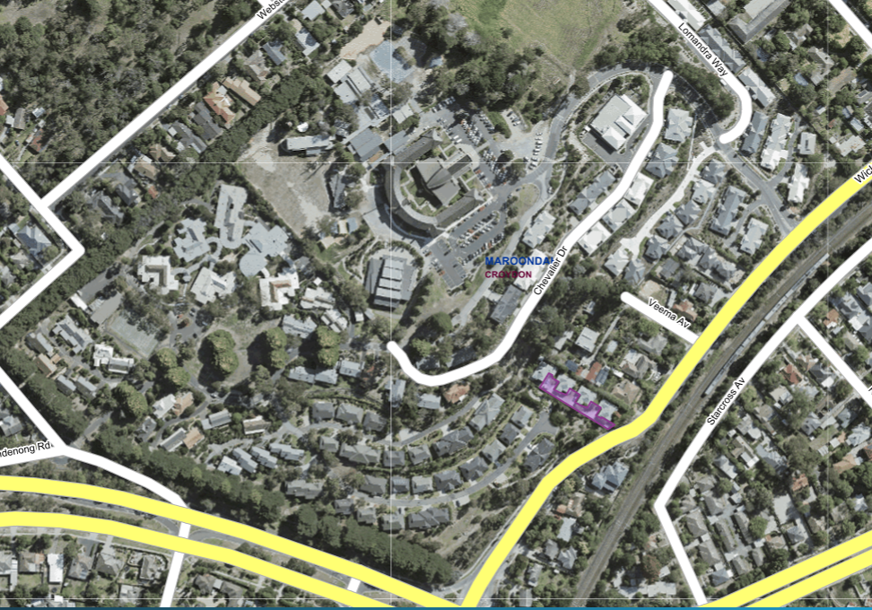
Complex sites

Slide 107
Australian Standard AS4819:2011 & UNGEGN
4.6.1 enduring road names
  Road names are intended to be enduring and shall only be changed when necessary.
  Resolution
  - importance of geographical names as part of a nation’s historical and cultural heritage.

Slide 108






Commercial names – inappropriate names
http://www.bbc.com/news/world-australia-41035706
https://www.theguardian.com/tv-and-radio/2017/aug/24/australia-geelong-names-streets-after-game-of-thrones-characters
http://www.geelongadvertiser.com.au/news/geelong/geelongs-new-game-of-thronesinspired-suburb-banned-from-naming-a-street-after-cersei-and-jaime-lannister/news-story/fedf49dffd7623e5eefbb43984cf45b6

Slide 109
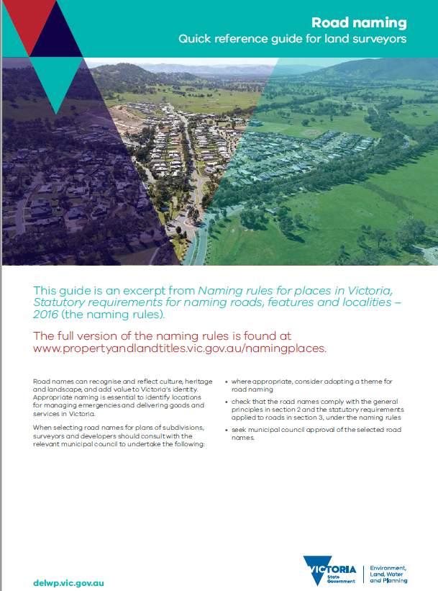
Quick reference guide for land surveyors
Road naming
Available online:
https://www.propertyandlandtitles.vic.gov.au/naming-places-features-and-roads/naming-rules-for-places-in-victoria

Slide 110

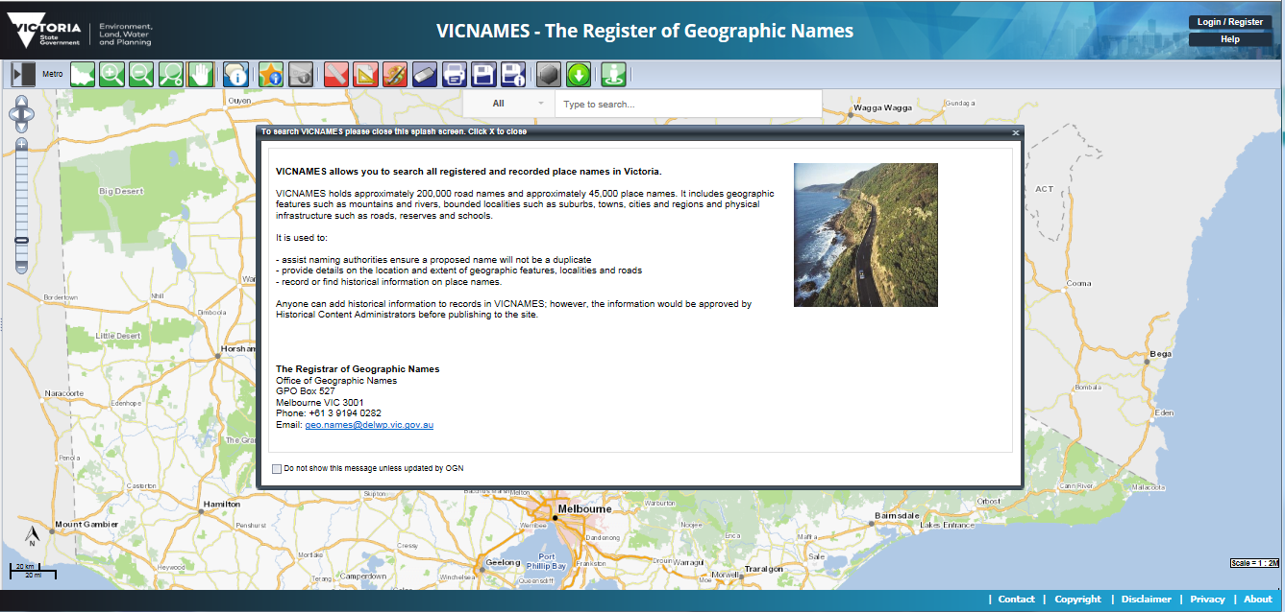
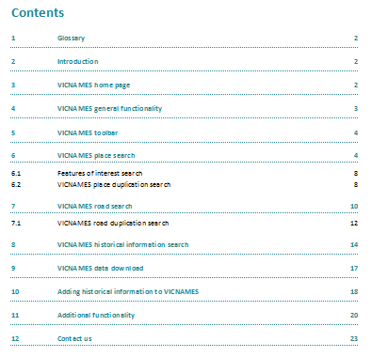
VICNAMES – The Register of Geographic Names
Register of Geographic Names - VICNAMES
How to

Slide 111


Slide 112
United Nations International Year of Indigenous Languages 2019
IYIL 2019
Key initiatives
  Documentaries
  Victorian Government Ministers
  Workshops
  Meeting rooms
  Reconciliation Action Plans
  Traditional Owner names / Register of Geographic Names - VICNAMES
  Promoting partnerships and celebrating
Workshops
Involvement

Slide 113
Naming rules for places in Victoria
Thanks for listening & Questions?

Slide 114
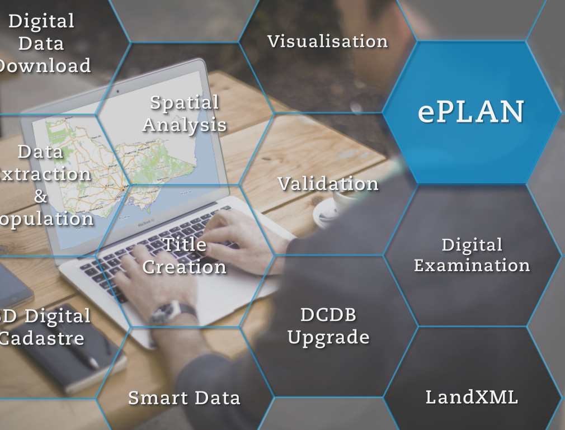

ePlan Update

Slide 115

ePlan 2025 Vision
Implement ePlan for all Victorian 2D & 3D cadastral plans & surveys by 2025

Slide 116
ePlan 2025 Roadmap
All 2D subdivisions NO GREATER than 10 lots to be provided in ePlan
(2D)
All plans and surveys to be provided in ePlan
(2D & 3D)
ePlan Pilot
All plans and surveys to be provided in ePlan
(2D)
Support all plan types
(2D)
2018 - 2019
2020
2021
2022
2025

Slide 117
Recent / Ongoing Initiatives (2016 - 2019)
Improved the visualisation of plan presentation
Conducted an ePlan Engagement Program
Contracted the ePlan project with University of Melbourne (CSDILA – The Centre for Spatial Data Infrastructures & Land Administration)
Developed the Visualisation Enhancement Tool (VET)
Developed a database for storing registered ePlans
Commenced ePlan Pilot Program – plans no greater than 10 lots
Testing ePlan software products
Training surveyors of ePlan creation
Investigated requirements of supporting multi-lot plans through case study

Slide 118
Current Initiatives (2019)
Extending the resources of the SPEAR team to support surveyors
Investigating possible solutions to facilitate the ePlan creation
Developing a new ePlan Data Viewer
Developing VET to efficiently support multi-lot plans
Updating and improving the Validation and Visualisation services
Developing a 3D digital cadastre roadmap
Collaborating with Digital Cadastre Modernisation team
Notes:
.

Slide 119
ePlan Pilot Update (Mar2018-Jun2019)

Slide 120
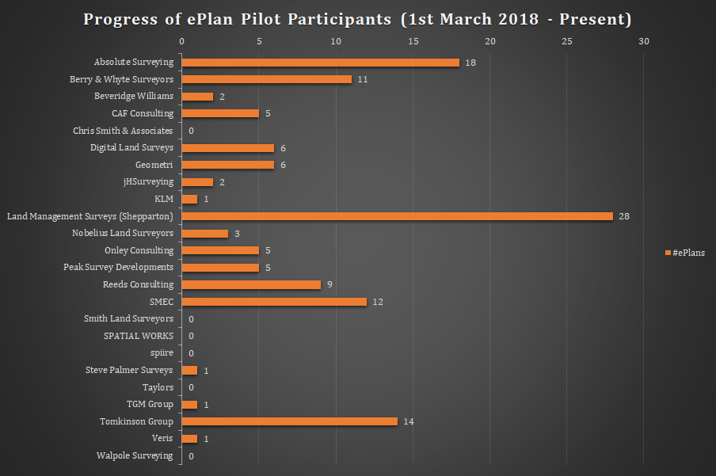
ePlan Pilot Update – Participants’ Status

Slide 121
ePlan Pilot Update – Participants’ Status
Surveying firms that have achieved the incentive for quicker registration of non-ePlan applications during the pilot timeframe:
  Absolute Surveying
  Land Management Surveys – Shepparton
  SMEC
  Tomkinson Group
  Berry & Whyte Surveyors
  Reeds Consulting (1 more to go)

Slide 122


ePlan Support Procedure
ePlan enquiries received in spear.info@delwp.vic.gov.au
Enquiry assigned to ePlan/SPEAR Service Desk team members
Response provided in timely manner with clear instructions
ePlan Submission
Davood
Farshad
Anthony
Vernon
Lodgment notification received in spear.info@delwp.vic.gov.au
ePlan assigned to a designated examiner
Examiner processes ePlan - target of 5 business days
ePlan Registration
Carlos
Randall
Anthony
Vernon

Slide 123
ePlan Pilot - Case Studies
Benefits in participating in a case study:
  For ‘LUV’ to evaluate the ePlan Services in terms of supporting multi-lot subdivisions
  For ‘Surveyors’ to understand the ePlan creation process and making ePlan fit into their business processes
  For ‘CAD Vendors’ to realise the potential gaps/enhancements in their packages from resultant feedback
Defined case studies:
  Reeds Consulting – 27 lots
  Beveridge Williams – 55 lots, 35 lots and 27 lots

Slide 124
Multi-lot ePlan Case Study Workflow
Preparing data
Creating ePlan LandXML
Reporting enhancements to software vendors
Identifying and resolving Visualiser and VET bugs/ enhancements
Sharing the ePlan file and instructions with surveying firms

Slide 125
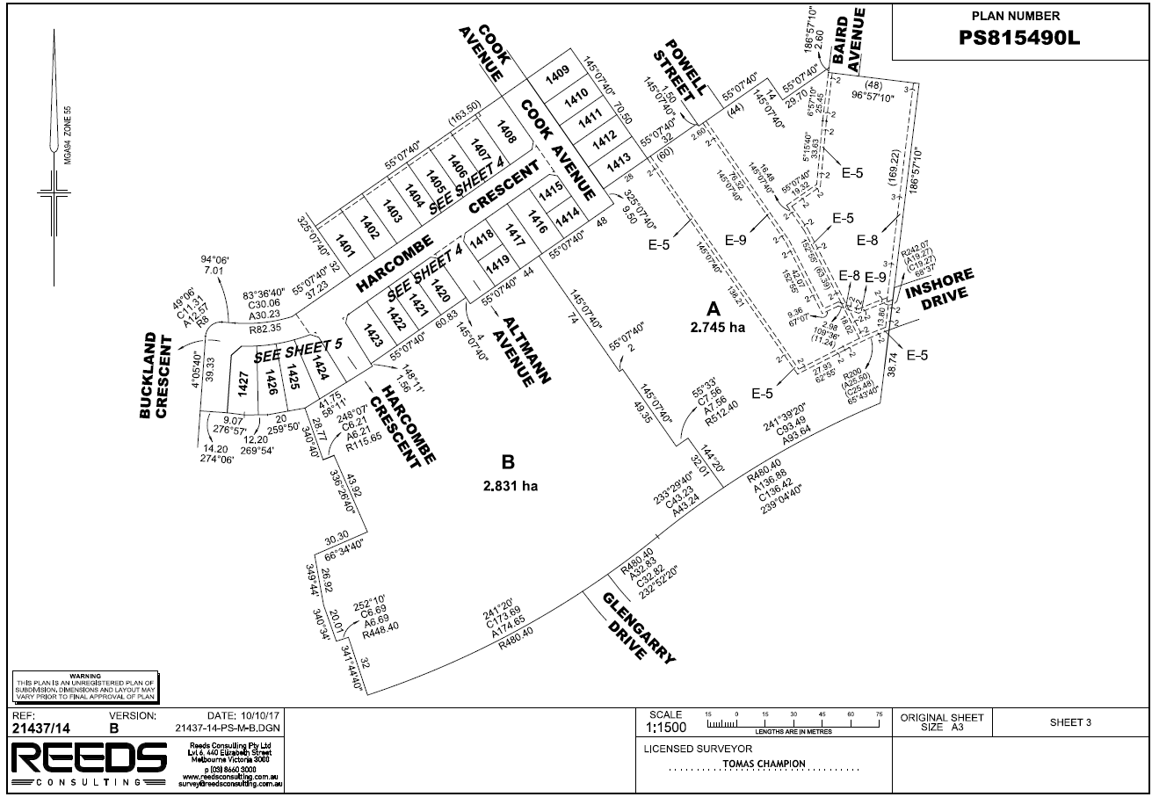

Slide 126
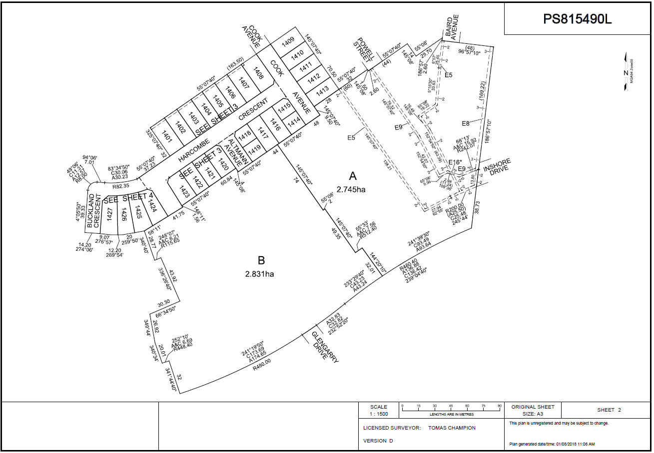


Slide 127
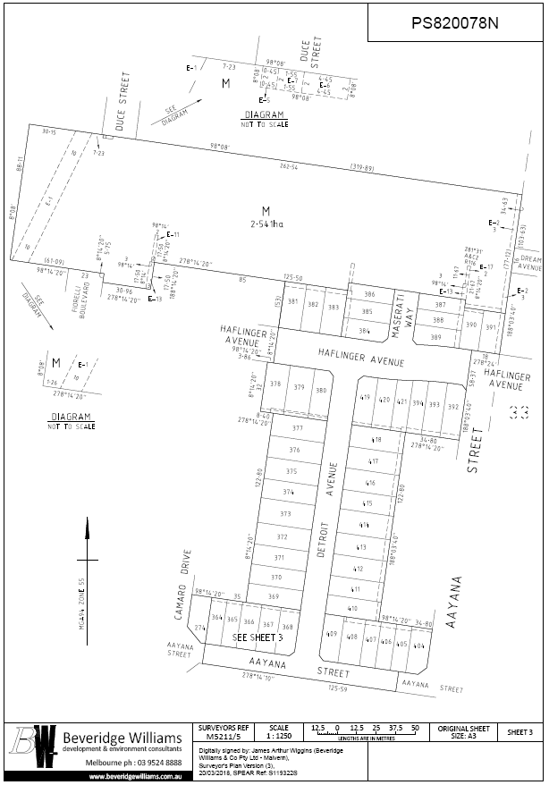
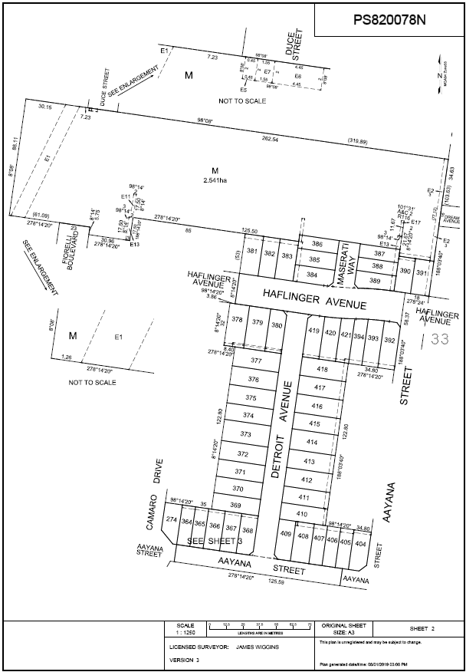


Slide 128
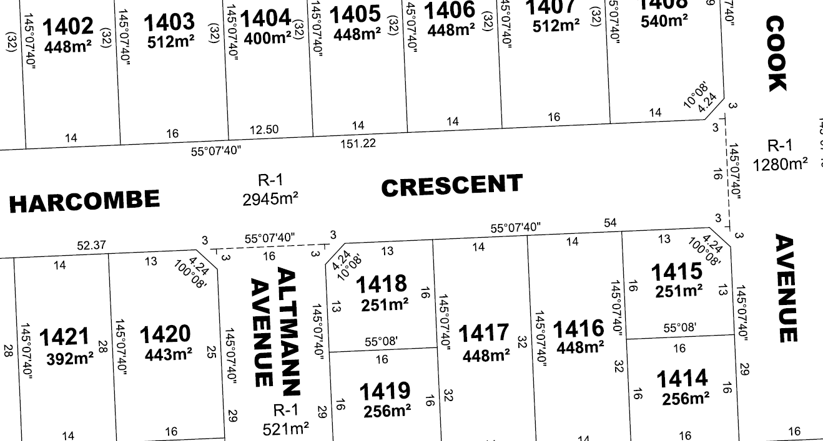
ePlan Case Studies – Lessons Learnt
Data preparation:
  Making data consistent with ePlan requirements (e.g., easements should be captured using polygons)
Software enhancement:
  Support multipart created roads

Slide 129
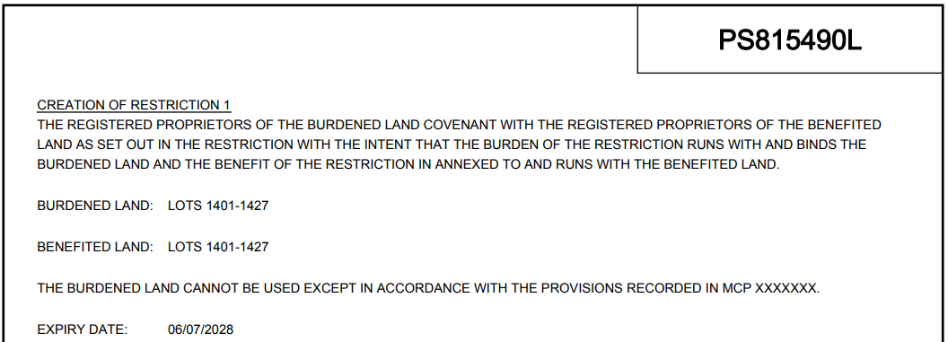
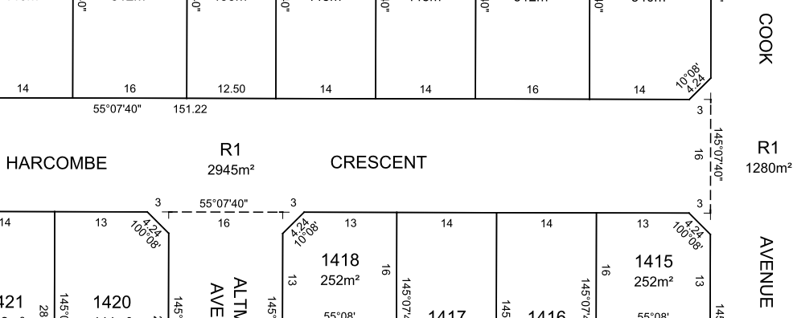
ePlan Case Studies – Lessons Learnt
More than 40 enhancements for Visualisation Service and VET:
  Supporting the new Land Registry’s policy on Restrictions
  Displaying a dashed line between parts of created road R1

Slide 130
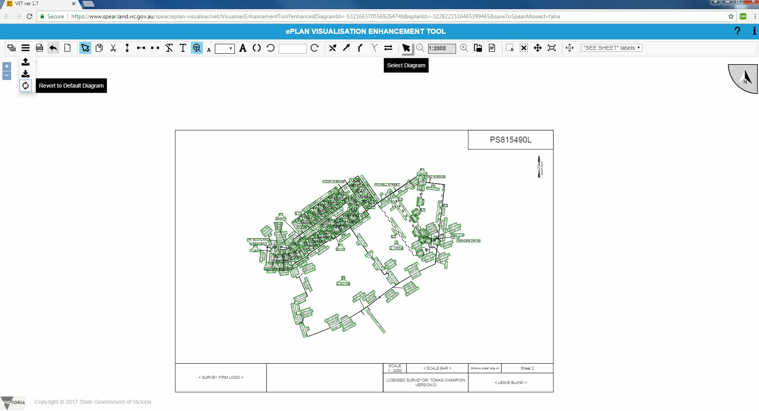
ePlan Case Studies – Lessons Learnt
Difficulty in VET to create the ‘Key (Index) Sheet’ for multi-lot plans

Slide 131
ePlan Services Update

Slide 132
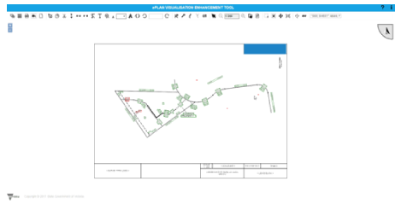
ePlan Services Update
Title connections enhancement functionality in VET
Watch video here:
https://www.youtube.com/watch?v=noBSiTKB8-g&list=PLh99LjdTvxrsjoif4pGbModCDDBypCpnu&index=2&t=0s

Slide 133
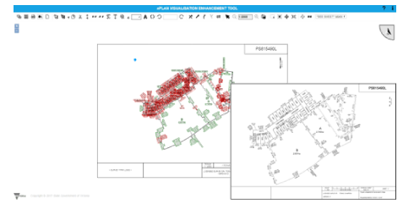
ePlan Services Update
Layering functionality in VET
Watch video here:
https://www.youtube.com/watch?v=k14H9xxpbY8&list=PLh99LjdTvxrsjoif4pGbModCDDBypCpnu&index=3&t=0s

Slide 134
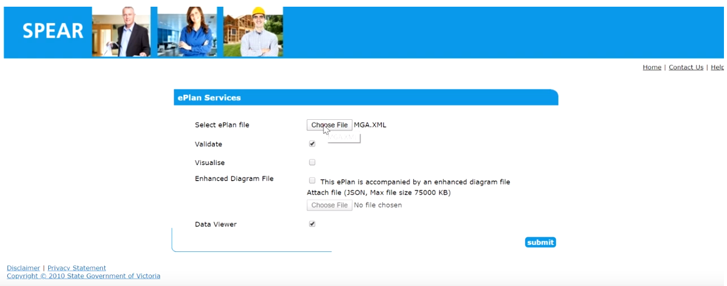
ePlan Services Update
Current ePlan Data Viewer
Watch video here:
https://www.youtube.com/watch?v=QEheJxyvxPI

Slide 135
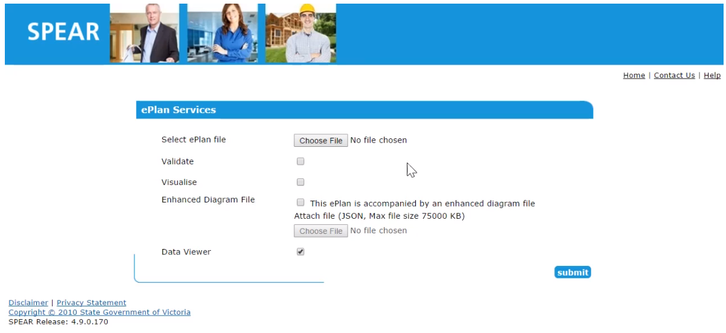
ePlan Services Update
New ePlan Data Viewer
Watch video Here:
https://www.youtube.com/watch?v=efESczGb6ew&list=PLh99LjdTvxrsjoif4pGbModCDDBypCpnu&index=5&t=0s

Slide 136
ePlan Software Update
LISTECH Neo
  ePlan module is now available
  First workshop was held in Dec 2018
Stringer ePlan
  The manual and workbook are available on SPEAR website/ePlan/Surveyors/Stringer ePlan Resources
  SPEAR Service Desk is in the process of preparing training videos which are being added to the SPEAR website

Slide 137
Deriving Further Benefits from ePlan through New Technologies

Slide 138

GeoCity and Augmented Reality (AR) Demo
Watch video Here:
https://www.youtube.com/watch?v=6pe_YOxYUlM&list=PLh99LjdTvxrsjoif4pGbModCDDBypCpnu&index=6&t=0s

Slide 139

Victorian 3D Digital Cadastre Roadmap – Progress To-date
Virtual Fishermans Bend pilot project and live testbed has been recommended to verify the outcomes of the non-technical and technical projects
3D Data Capturing
3D Data Modelling
3D Data Storage
3D Data Submission
3D Data Validation & Examination
3D Data Visualisation and Analysis
Projects
15 technical and non-technical projects have been identified with timeframes
VISION:
SMART CADASTRE, SUSTAINABLE VICTORIA
2019
2025
Enablers
The 3D digital cadastre enablers (e.g. awareness and capacity building campaign, project governance, cost/benefit analysis, etc.) are being identified
The existing relevant initiatives (e.g. UN SDGs, Digital Cadastre Modernisation Project, GDA2020, Victorian Digital Asset Strategy, VICMAP 3D Enablement, etc.) are being identified and linked to 3D digital cadastre

Slide 140
Post ePlan Pilot Incentive
Land Use Victoria will continue to offer the 5-business day registration target for ALL ePlans after 30th June 2019

Slide 141
Co-design of standard CAD file
An initiative by Surveyor-General of Victoria
Standardising the CAD file format through a co-design approach with LUV and the surveying profession, being led by Craig Sandy

Slide 142
Proposal – CAD file to LandXML conversion
Proposal to streamline the ePlan creation process by developing functionality to convert the standard CAD file to an ePlan LandXML file
Develop web services that include:
CAD to LandXML conversion
LandXML to enriched CAD conversion
Automating the ePlan metadata population based on Vicmap property, Vicmap admin, Vicmap address, SMES, SRBV, etc
CAD validation to check the CAD file against the standard structure

Slide 143
SPEAR Service Desk Update

Slide 144
Release 4.8 Highlights

Slide 145
Release 4.8
  Release 4.8 was released to production in November 2018
  Release Notes are available from the SPEAR website at:
  www.spear.land.vic.gov.au > About > About the Application > Release Notes

Slide 146
Release 4.8
New Dealing Types in SPEAR
  Surveying firms can create new dealings in SPEAR:
    Transfer of Land Act (TLA):
      Creation of Easement (Section 45)
      Notification of Easement (Section 72)
      Acquisition of Easement of Right (Section 88(2))
    Local Government Act:
      Transfer of Closed Road (Section 207D)
      Road Exchange (Section 207E)
      Road Alignments (previously located under the Transfer of Land Act application type)

Slide 147
Release 4.8
New Dealing Types in SPEAR
  New Dealing Type ‘Other’:
    Amend Scheme of Development - Owners Corporation (Section 38B)
    Amend Scheme of Development - Lot Owner (Section 38C)
    Major Transport Projects Facilitation Act (MTPFA)
    Supporting Plan Document
    The Supporting Plan Document can be used when the surveyor is required to supply survey information to a lodging party in support of a dealing type not processed in SPEAR (i.e. a caveat or a transfer to Queen as to part)

Slide 148
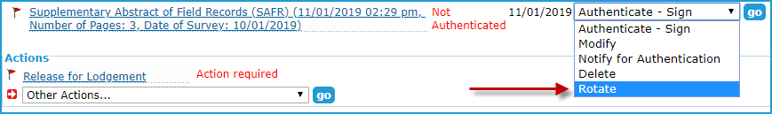
Release 4.8
Rotation of SAFR
  The Supplementary Abstract of Field Records document can now be rotated once it has been added
  This will assist Applicant Contacts to correct issues with placement of the signing watermark

Slide 149
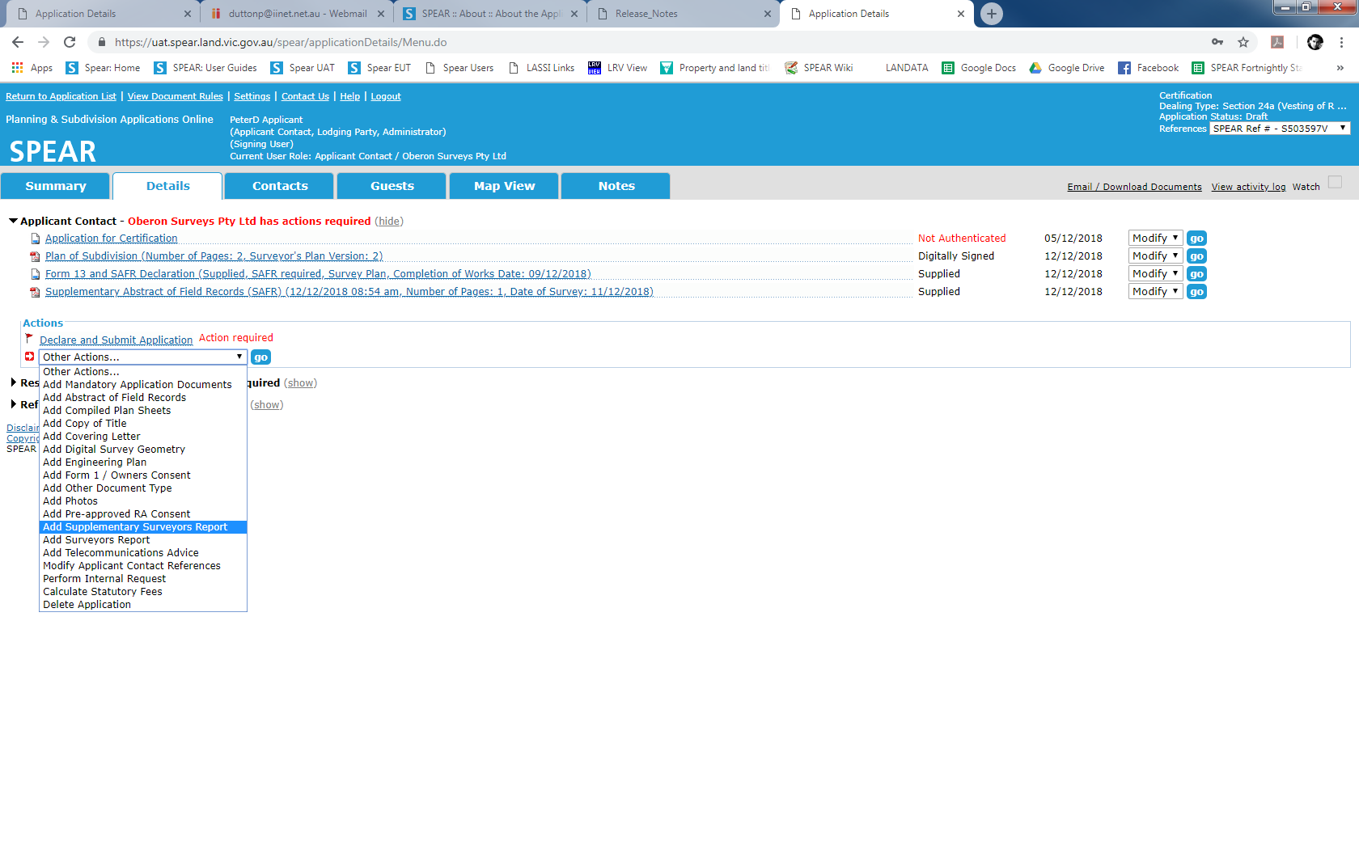
Release 4.8
Add Supplementary Surveyors Report
  Applicant Contacts now have the option to supply a
  Supplementary Surveyors Report to support the Supplementary Abstract of Field Records (SAFR) document

Slide 150

Release 4.8
Refuse Certification (Form 16)
Councils can now complete the Form 16 (Refuse Certification) on screen instead of attaching a PDF

Slide 151

Release 4.8
Refuse Certification (Form 16)
You then select the required options to create the Refusal (Form 16)

Slide 152

Release 4.8
Designated Contacts
  Council can now assign two separate designated contacts for a joint application

Slide 153

Release 4.8
Enhanced Recertification Process
  When the user selects ‘Add Application to amend certified plan (Form 8)’, they will be required to first upload the new plan document (PDF or ePlan), before proceeding to the Form 8 screen

Slide 154

Release 4.8
Enhanced Recertification Process
  On this screen you will complete any other details being changed

Slide 155
Release 4.8
Enhanced Recertification Process
  Note:
  If an ePlan Land XML file is supplied, SPEAR will prepopulate known information into the Form 8 screen, including any changes to the plan number, dealing type or number of lots
  After completing the Form 8 requirements, the user is returned to the Details screen where they must authenticate the amended documents before submitting the proposed changes to the Responsible Authority

Slide 156
Release 4.8
Council Recheck Street Addressing
  Council is now prompted to re-check street addressing if a plan is modified after the addressing is completed and prior to certification or re-certification
  This is displayed as a mandatory action, with the following options:
  No changes required to New Street Address Allocations
  Modify New Street Address Allocations

Slide 157
Release 4.8
Notes Tab Indicators
  The Notes tab now has an indicator to show the status of the note (read or unread):
  A red tick will be displayed if there is a new note added by another user which has not been read by the logged-in user
  A blue tick will be displayed if there is a note added by the logged-in user or, if there is a note added by another user which has previously been read by the logged-in user

Slide 158
Release 4.8
Deactivate SPEAR User Accounts
  SPEAR users who have not logged in to SPEAR for 12 months will be automatically deactivated
  If required, these accounts can be reactivated by your Local Administrator or by the SPEAR Service Desk
  NOTE: Reactivate old user accounts rather than creating new accounts!

Slide 159


Release 4.8
How to Reactivate SPEAR User Accounts
  Click ‘Show permanently inactive users’ on the Manage Users screen
  Select the User ID you wish to reactivate and change ‘Permanently Inactive’ to ‘Active’, then click ‘Update user’

Slide 160
Other Matters

Slide 161
Recruitment
The SPEAR Service Desk has been expanded with two new additional Project Officers
Ongoing support of all SPEAR users
Supporting surveyors with the additional application types
Signing up and training of lodging parties
Supporting lodging parties in the use of SPEAR
Supporting surveyors with ePlan creation issues
Continue our SPEAR and ePlan Engagement programs

Slide 162
Reminder: Nominate lodging method
Applicant Contacts can nominate a lodging party at any time between the application being submitted to council and released for lodgment
Applications previously nominated in paper may be modified to be a SPEAR electronic lodgment, prior to release for lodgment

Slide 163

Reminder: Nominate lodging method
Select lodgment via SPEAR and begin typing the name of the lodging party
If there are no matches then select paper

Slide 164
Reminder: Nominate lodging method
Thank you
Thank you to all the Applicant Contact firms who have promptly responded to our requests to change their paper nominations to electronic lodgments
This has been an important aspect of our ELN training, and provides for more relevant training when lodging parties are able to deal with real examples

Slide 165
Changes to the Form 13 and Supplementary Abstract of Field Records
In May 2018, SPEAR consolidated the Form 13 – Advice by Licensed Surveyor and Supplementary Abstract of Field Records (SAFR) Declaration into a single Form 13 and SAFR Declaration
Further to this change and following user feedback, SPEAR has altered the parameters around when the document is available and when the mandatory action is presented to Applicant Contacts

Slide 166
Changes to the Form 13 and Supplementary Abstract of Field Records
To allow the Responsible Authority to issue the SOC, one of the following options must be completed:
Mandatory Action to ‘Add Form 13 and SAFR Declaration’:
This action becomes available when the status of an application reaches ‘SOC Decision Pending’
Other Actions:
Applicant Contacts can use the other actions drop-down list to supply the Form 13 and SAFR Declaration at any time
Defer Form 13 and SAFR Declaration:
Applicant Contacts can defer supplying the Form 13 and SAFR Declaration if works are required and not yet completed

Slide 167
Importing permit conditions
SPEAR met with a number of growth area councils to discuss how to streamline the manage conditions process
A grant has been provided to growth area councils by the VPA to assist with this
A number of options were workshopped with the SPEAR team
Solution needs to be practical for councils and fit into SPEAR model

Slide 168
Importing permit conditions
Councils investigating excel template (or word macro) for planning permits
PE1581 – SPEAR to support new excel template to import conditions for:
  generating a planning permit, and/or
  creating a manage conditions document
SPEAR to wait for advice from growth area councils before scheduling this change

Slide 169
LASSI - SPEAR
Late last year, a survey labels related issue in LASSI was identified:
  Only survey labels that met a certain criteria were being displayed in LASSI-SPEAR
This was resolved in December 2018 with a configuration change was made to LASSI-SPEAR to display and retrieve all survey labels and their associated documents

Slide 170
New Java Licensing Agreement
Reminder to Signing Users
All signing users require Java to be installed on their computers to enable digital signing
Java Version 8, Update 201 is free for commercial use
The next version, released on 16 April 2019 requires commercial users to pay a subscription fee

Slide 171
New Java Licensing Agreement
Reminder to Signing Users
SPEAR is planning to implement an alternative to JAVA in the next 12 months. Until then, SPEAR signing users can either:
  Continue using Java Version 8, Update 201, free of charge, without any updates or bug fixes
  Purchase a commercial Java subscription. More information available on the JAVA website (approximately $US30 per user/year)

Slide 172
New Java Licensing Agreement
Reminder to Signing Users
Organisations wishing to continue using Java for free will need to decline any prompts to install new versions of Java from April 2019
This information has been published in the April Edition of SPEAR Bulletin (05/04/2019), and Broadcast Message (04/04/2019)

Slide 173
Reminder: SPEAR Training Dates
SPEAR training is hosted at 2 Lonsdale Street, Melbourne.
Please register your interest with the SPEAR Service Desk
Tuesday | 14 May | Applicant Contacts
Tuesday | 14 May | Referral Authorities
Thursday | 16 May | Responsible Authorities (Councils) - full
Tuesday | 6 August | Responsible Authorities (Councils)
Tuesday | 6 August | Internal Referrals
Thursday | 15 August | Applicant Contacts
Thursday | 15 August | Referral Authorities
Tuesday | 12 November | Applicant Contact
Tuesday | 12 November | Referral Authorities
Thursday | 21 November | Responsible Authorities (Councils)

Slide 174
Closing and Questions

Slide 175
Lunch

